Slide 1
Distributed System Concepts and Architectures
8320 Advanced Operating Systems Lanier Watkins

Slide 2
Outline
Fundamental Distributed Operating System Design-1997
  Transparency
  Service Oriented
Architecture-1997
  Workstation-Server
  Processor-Pool
Protocol Models-1997
  OSI
  TCP/IP
Design Issues-1997
  Object Model
  Naming Scheme
  Interprocess Communication

Slide 3
Outline (Continued)
  Synchronization
  Data Sharing
  Replication
  Failure
  Recovery
Distributed Computing Environment (DCE)-1997
  Open Software Foundation
  What Makes Up a DCE?
DCE Implementations-1997+
  Design
  Architecture
  Design Issues
  Advantages
  Disadvantages

Slide 4
Transparency-1997
Most frequently used identifier of a distributed system
Provides logical view of system but hides the disparate entities within the system
Several aspects of Transparency
  Access: Hides details of remote or local access
  Location: Hides the location of object (local or remote)
  Migration: Allows to move locations and keep their name
  Concurrency:Hides details of sharing objects (local or remote)
  Replication: Hides existence of multiple copies of objects or files
  Parallelism: Hides details of parallel activities across entire system
  Failure: Allows for graceful degradation in light of failures across system
  Performance: Allows for consistent performance levels across system
  Size: Allows for incremental system growth without user awareness
  Revision: Allows for revisions in system without user awareness

Slide 5
Services-1997
Primitive Services
  Must be implemented in the kernel
    Kernel must provide
      Communication
      Synchronization
      Processor Multiplexing (Process Serving)
Services by System Servers (Major Servers)
  Name server is the most essential, it provides a name per service
  Network server handles routing of information
  Time server provides synchronizing and scheduling abilities
Value Added Services
  Not essential, but adds support
  Examples
    Group Server
    Web Server

Slide 6
Architecture Models-1997
Workstation-server Model
  Workstation may be a stand alone system or a part of a network
Processor-pool Model
  Provides processing power on a demand basis
Integrated Hybrid Model (Desktop Grids-1997+)
  Workstations used as processor pools

Slide 7
Protocol Models-1997
OSI Model
  7 Layers
    Applications
    Presentation
    Session
    Transport
    Network
    Data Link
    Physical
TCP/IP
  4 Layer
    Application
    Transport
    Internet
    Physical

Slide 8
Design Issues-1997
Object Model and Name Scheme
  Objects in a computer
    Processes
    Data Files
    Memory
    Devices
    Network
    Processors
  Objects are encapsulated in servers and only visible as such
  3 Ways of Identifying Servers
    By Name
    By physical or logical address
    By service

Slide 9
Design Issues-1997
Distributed Coordination
  3 Types of Synchronization Requirements
    Barrier Synchronization: Events must reach common point
    Condition Coordination:Events must wait for a certain condition
    Mutual Exclusion: Concurrent processes must have mutual exclusion when accessing a critical shared resource
  Coordination can be centralized into one role that is moved from one process to another
Deadlock
  May be impractical to prevent
  Most practical is recovery
Interprocess Communication
  Message passing is the lowest level of communication

Slide 10
Design Issues-1997
  Client/Server Model and RPC are high level communication models that hide the details of message passing
    Client/Server Model
      Programming paradigm for structuring processes in distributed systems
      Client sends a request to server and server sends a response
    Remote Procedure Call (RPC)
      Built on top of Client/Server Model which is on top of message passing
      Standard for interprocess communication
      RPC is unicast but group communication is multicast
Distributed Resources
  Goal of distributed processing is to distributing processes to disparate processors
  Static load distribution is multiprocessor scheduling, its goal is to minimize completion time
  Dynamic load distribution is load sharing, its goal is to maximize processor utilization
  Distributed file system and distributed shared memory are plagued by replication of data issues

Slide 11
Design Issues-1997
Fault Tolerance and Security
  Failures are faults due to unintentional intrusion
  Security Violations are faults due to intentional intrusion
  Redundancy alleviates failures

Slide 12
Distributed Computing Environment-1997
Open Software Foundation (OSF)
    Kernel and Transport Service: Interface to hardware
    Processes and Threads: Basic computational units
    RPC and Group Communication: Communication methods for all other services
    Basic System Services: Time, name and process
    Distributed File Service: Primary objects
    Distributed Services: Built on top of the primary objects
    Distributed Applications: Interfaces with user
    Distributed Security and Management: Integrated into all layers

Slide 13
Distributed Computing Environment-1997
Applications
Distributed Services
Concurrency control, group management, etc
Distributed File Service
Security
Management
Basic System Services
Time, name, process services, etc
RPC and Group Communication
Processes and Threads
Kernel with transport service

Slide 14
DCE-(Vaughan-Nichols,2002)
Globe Project-Holland’s Vrije University
  Design
    Object Based, 5 Components
      Control: Manages clients request
      Communications: Enables inter-object communication
      Replication: Manages coherence of replicated objects
      Security: Control access rights and availability
      Semantics: Implements the object’s action
  Architecture
    Multi-Tiered (P2P)
  Design Issues
    Standard Academic Issues

Slide 15
DCE-(Gannon et al,2002)
Open Grid Services Architecture (OGSA)
  Design
    Based upon Web Services (ports that are service endpoints)
    Web Services Description Language: XML language used to describe Web Service
    Universal Description Discovery and Integration: Mechanism needed to discover Web Resources
    APIs that can be accessed over a network, such as the Internet, and executed on a remote system hosting the requested services.
  Architecture
    Multi-Tiered (P2P)
      RPC Web services
      Service-oriented architecture (SOA): More loosely coupled than RPC
  Design Issues
    Interoperability between implementations
    Extensibility not standardized
    Usability questionability

Slide 16
DCE-(Adiga et al,2005)
United Devices Grid MP
  Design
    Web Services Based
    Grid MP system consists of a set of servers providing grid services
    Grid MP resources run a lightweight Agent
  Architecture
    Multi-Tiered (P2P) or Client/Server
      Batch Jobs
      MPI Jobs
      Data-parallel jobs
Design Issues
  Resource Discovery-Unreliable resources
  Replication-Same job executing on multiple machines

Slide 17
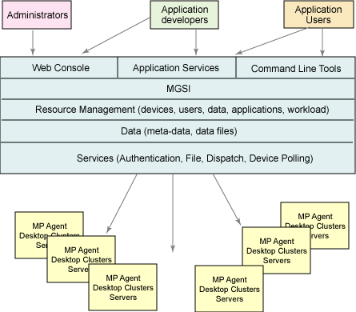
DCE-(Adiga et al,2005)
United Devices Architecture

Slide 18
DCE-(Ren et al,2006)
Fine Grained Cycle Sharing (Desktop Grid)
  iShare
    Design
      Based on Web Services
      Uses Resource Description Framework (RDF): An evolutionary stage of the World Wide Web in which automated software can store, exchange, and use machine-readable information distributed throughout the web
      APIs
    Architecture
      Multi-Tiered (P2P)
    Design Issues
      Failure Recovery
      Coherency
      Other Academic Issues

Slide 19
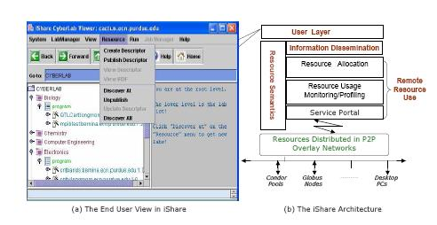
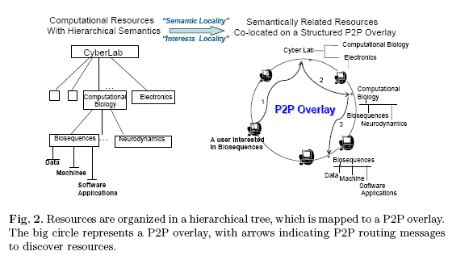
DCE-(Ren et al,2006)
iShare Architecture

Slide 20
References
Distributed Operating Systems & Algorithms, Randy Chow and Theodore Johnson, Addison Wesley, 1997
Resource Availability Prediction in Fine-Grained Cycle Sharing, Xiaojuan Ren, Seyong Lee, Rudolf Eigenmann, Saurabh Bagchi, Systems. HPDC'06, Paris, France. June, 2006
Developing the Distributed-Computing OS, Vaughan-Nichols, S.J.; Computer Volume 35, Issue 9, Sept. 2002 Page(s):19 - 21
An Analysis of The Open Grid Services Architecture D. Gannon, K. Chiu, M. Govindaraju, A. Slominski Commissioned by the UK e-Science Core Program, White Paper, http://www.extreme.indiana.edu/~aslom/papers/ogsa_analysis3.html
Grid in action: Harvesting and reusing idle compute cycles, How United Devices Grid MP helps this happen at the UT Grid project, Ashok Adiga, Nina Wilner, developerWorks June 2005, http://www-128.ibm.com/developerworks/grid/library/gr-harvest/?ca=dgr-lnxw01HarvestingGrid

